Slide 1
Clean Code
Methods & Techniques for better Code
by Nicolas Wagner

Slide 2
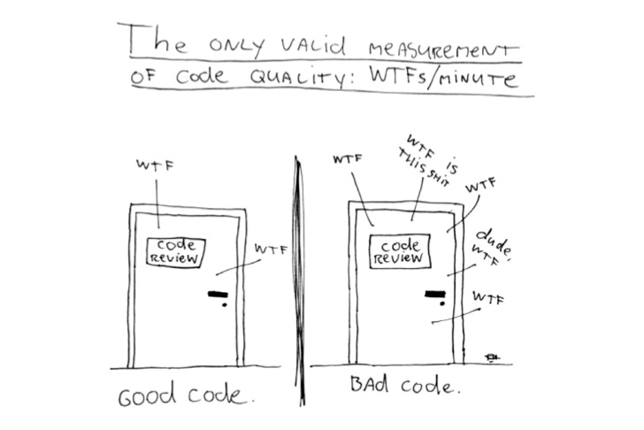

Slide 3
Content
Importance of Clean Code
Clean Code – Characteristics
Meaningful Names
Methods
Comments
Formatting
Let‘s do it!

Slide 4
Importance of clean code
1

Slide 5
Clean Code - definitions
no duplication
elegant
simple
direct
focussed
clear
efficient
purpose fulfilling
2

Slide 6
Reasons for bad code
Time Pressure?
Desire of Finalization?
Too much Work?
3

Slide 7
clean code - Principles
Read-Write: >10 : 1
SRP – Single Responsibility Principle
DIP – Dependency Inversion Principle
OCP – Open-Closed Principle
Style
Readable Code
for every Developer
4

Slide 8
Characteristics of clean code
5

Slide 9
Characteristics - OVerview
Meaningful Names
Methods
Comments
Formatting
6

Slide 10
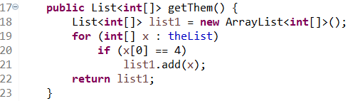
7

Slide 11
Meaningful names
Choose pronounceable Names
Avoid single-digit Names
Describe the Purpose
Code readable like a Newspaper
Avoid part-names: “List“, “Controller“, “Manager“, …
8

Slide 12
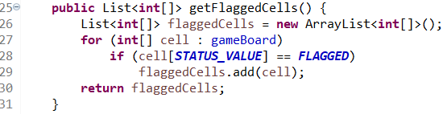

9

Slide 13
Characteristics - OVerview
Meaningful Names
Methods
Comments
Formatting
10

Slide 14
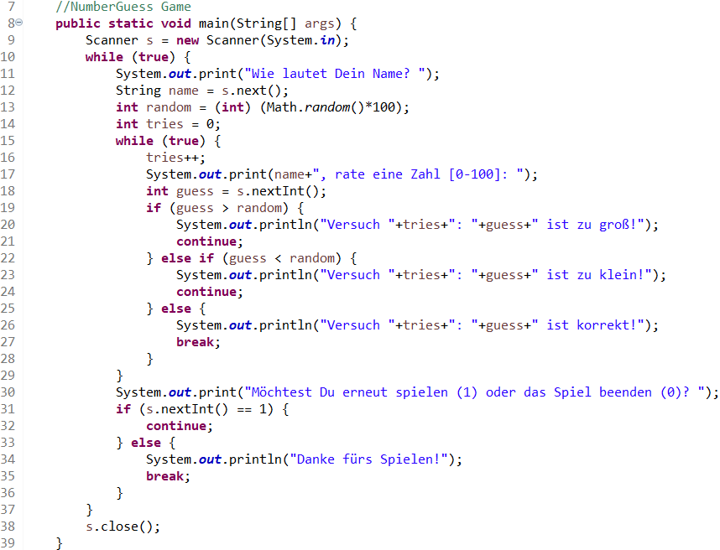
Methods
11

Slide 15
Methods
Size: Max. 50-100 lines Best Case: ~10 lines
SRP – One Task per Method
Multiple Abstraction Levels
Names: Use of “is“, “get“, “set“, “add“, …
Parameters: Maximum of 3
12

Slide 16
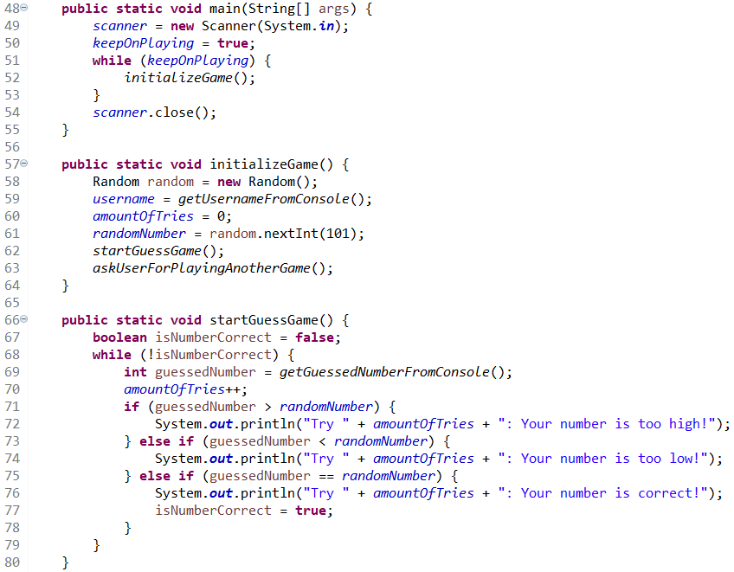
Methods
13

Slide 17
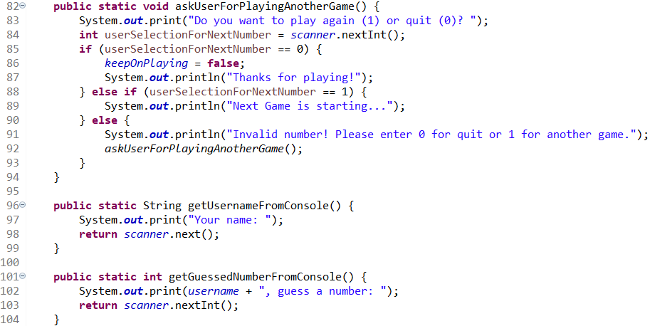
14

Slide 18
Characteristics - OVerview
Meaningful Names
Methods
Comments
Formatting
15

Slide 19
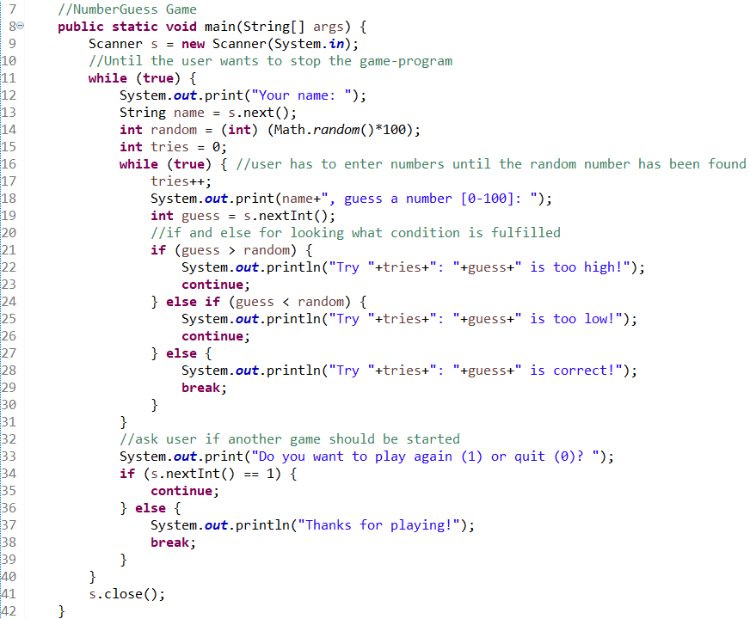
Comments
16

Slide 20
Comments
No Comment = Best Case
Appropriate Comments: law, informative, warning, TODOs
JavaDoc (public APIs)
Code commented out = Worst Case
17

Slide 21
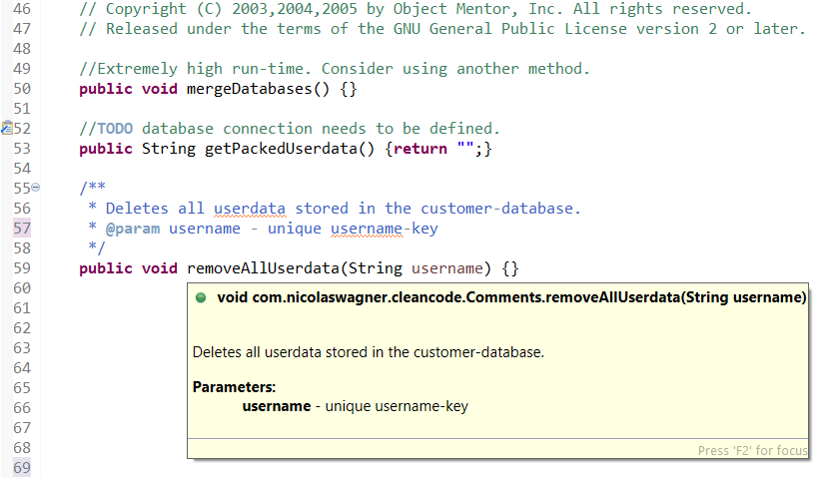
18

Slide 22
Characteristics - OVerview
Meaningful Names
Methods
Comments
Formatting
19

Slide 23
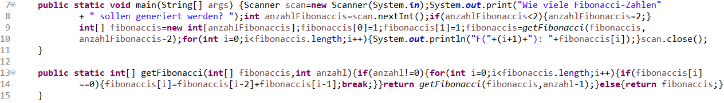
20

Slide 24
Formatting
Maximum: 200-500 lines ea. 100 characters per file
Common → Detail
Teamwork: Make use of a Formatter and guidelines
21

Slide 25
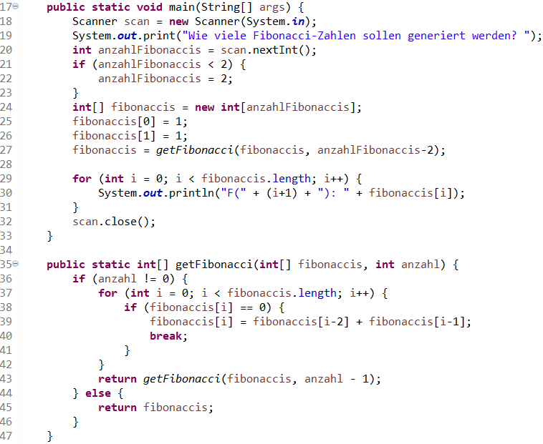
22

Slide 26

Recommendation & Source
23

Slide 27
Thank You for your attention

Slide 28
Let‘s do it! (https://github.com/niwa99/Clean-Code-Presentation-SE/blob/master/TaskDescription.md)

